Slide 1
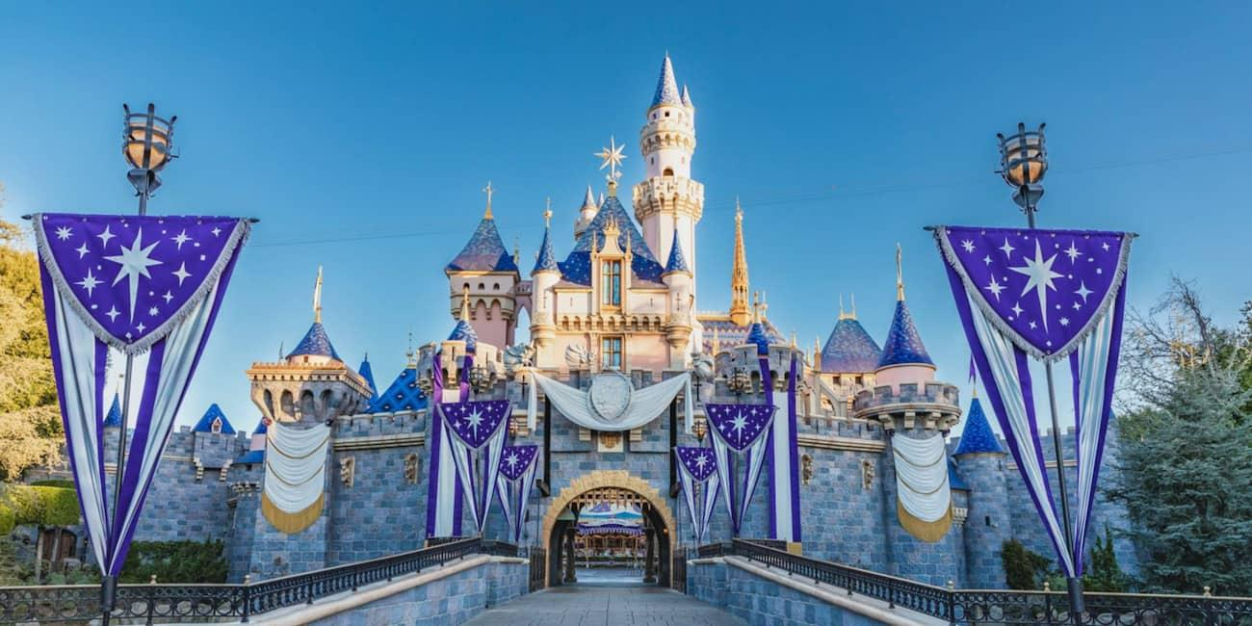
Tour Planning in Disneyland Resort
Qihan Jiang & Hongyi Zheng
DS-GA 3001 Final Project Proposal Presentation

Slide 2
Problem Statement
Tour planning is a necessary but complicated process for every visitor who wants to optimize their experience in the Disney Park.
Our project will train RL agent to make series of decisions of which ride/attraction to go to at different time-stamp based on the waiting time, which would allow visitors to enjoy as much of the park as possible.

Slide 3
Environment, State, Action, Reward
Environment: Constructed by a dataset of 500+ days data of California Disneyland, including the weather, waittime, fastpass waittime, and ride duration.
State: The state of the agent is constituted by the environment and its past actions. This includes waiting time of each available rides, fast passes, distance between current location and each rides, the rides that the agent has already taken, and weather.
Action: Available actions are all currently operating facilities that haven’t been visited yet.
Reward: The cumulative reward will be determined based on the number of rides attended, weighted by the popularity of each ride (based on rankings from the internet).

Slide 4
Potential Solutions
Challenges
Large (almost continuous state space)
Finite but relatively Large Action Space
Large Waiting Time Update Interval (~30 mins)
Potential frameworks and solutions
DQN
DDQN
Actor-Critic

Slide 5
Dataset/Resources
https://github.com/Jester565/DisneylandData
Disneyland data of 500+ days
https://touringplans.com/disney-california-adventure/attractions/duration
Rides Duration

